Slide 1
Nearest-Neighbor Classifier

Slide 2
Instance-Based Classifiers
Set of Stored Cases
Store the training records
Use training records to predict the class label of unseen cases
Atr1 | ……... | AtrN | Class
 |  |  | A
 |  |  | B
 |  |  | B
 |  |  | C
 |  |  | A
 |  |  | C
 |  |  | B
Unseen Case
Atr1 | ……... | AtrN

Slide 3
Instance Based Classifiers
Examples:
  Rote-learner
    Memorizes entire training data and performs classification only if attributes of record match one of the training examples exactly
  Nearest neighbor
    Uses k “closest” points (nearest neighbors) for performing classification

Slide 4
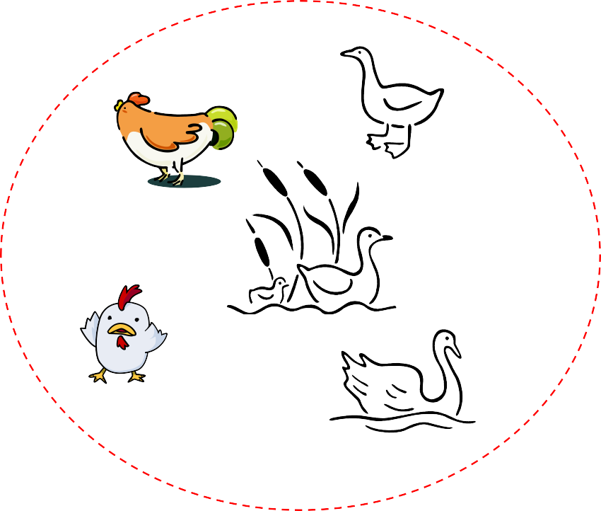
Nearest Neighbor Classifiers
Basic idea:
– If it walks like a duck, quacks like a duck, then it’s probably a duck
Compute Distance
Test Record
Training Records
Choose k of the “nearest” records

Slide 5

Nearest-Neighbor Classifiers
Unknown record
l Requires three things
The set of stored records
Distance Metric to compute distance between records
The value of k, the number of nearest neighbors to retrieve
l To classify an unknown record:
Compute distance to other training records
Identify k nearest neighbors
Use class labels of nearest neighbors to determine the class label of unknown record (e.g., by taking majority vote)

Slide 6

Definition of Nearest Neighbor
X
X
X
(a) 1-nearest neighbor (b) 2-nearest neighbor (c) 3-nearest neighbor
K-nearest neighbors of a record x are data points that have the k smallest distance to x

Slide 7
Nearest Neighbor Classification
Compute distance between two points:
Euclidean distance
d ( p, q) =
Manhatten distance
𝑑 𝑝, 𝑞 = ∑ 𝑝_{𝑖}
𝑖
∑ ( p − q )²
i
i i
− 𝑞_{𝑖}
– q norm distance
_{− 𝑞𝑖 𝑞)} 1/𝑞
𝑑 𝑝, 𝑞
= (∑_{𝑖} 𝑝_{𝑖}

Slide 8
Determine the class from nearest neighbor list
  take the majority vote of class labels among the k-nearest neighbors
  Weigh the vote according to distance

Slide 9
The KNN classification algorithm
Let k be the number of nearest neighbors and D be the set of training examples.
for each test example z = (x’,y’) do
Compute d(x’,x), the distance between z and every example, (x,y) ϵ D
Select D_{z} ⊆ D, the set of k closest training examples to z.
4. y’ = argmax ∑ _{𝒙𝑖,𝑦𝑖 ϵ 𝐷𝑧} 𝐼( 𝑣 = 𝑦_{𝑖} )
𝑣
5. end for

Slide 10
Nearest Neighbor Classification…
Choosing the value of k:
  If k is too small, sensitive to noise points
  If k is too large, neighborhood may include points from other classes
X

Slide 11
Nearest neighbor Classification…
k-NN classifiers are lazy learners
  It does not build models explicitly
  Unlike eager learners such as decision tree induction and rule-based systems
  Classifying unknown records are relatively expensive

Slide 12
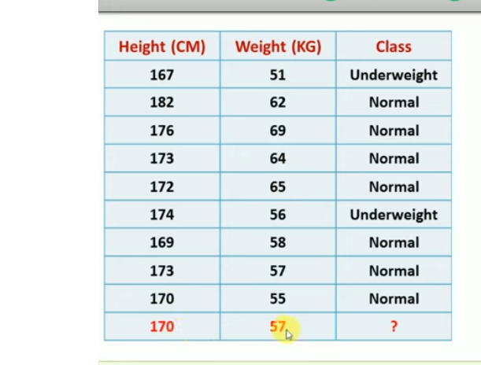

Slide 13


Slide 14
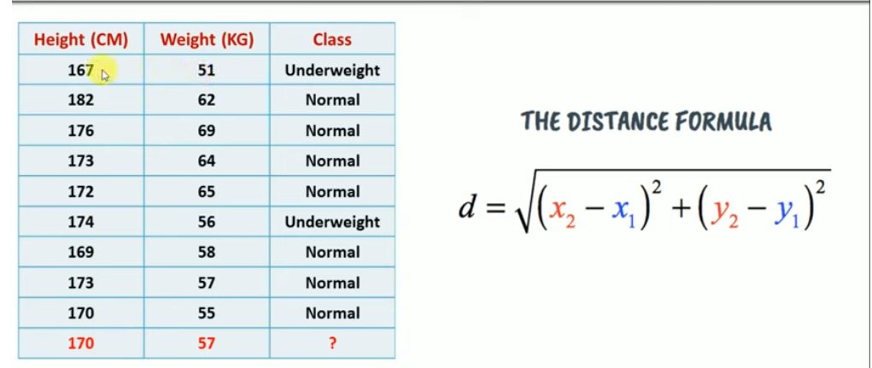

Slide 15
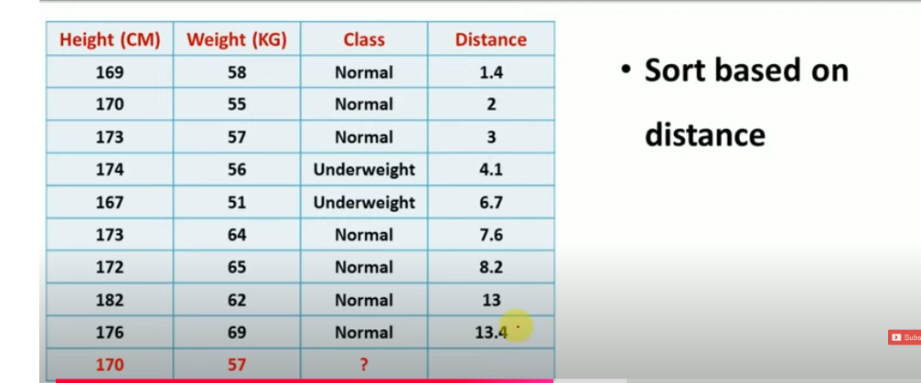

Slide 16
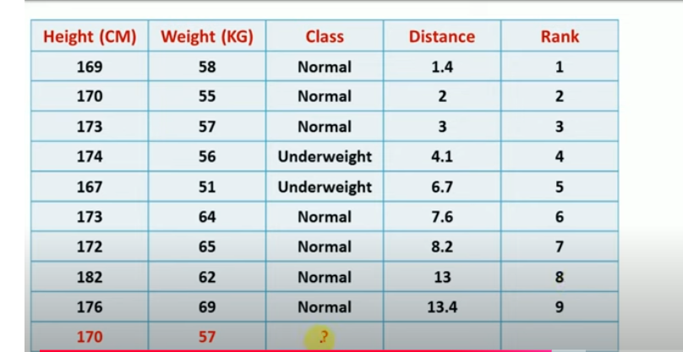

Slide 17
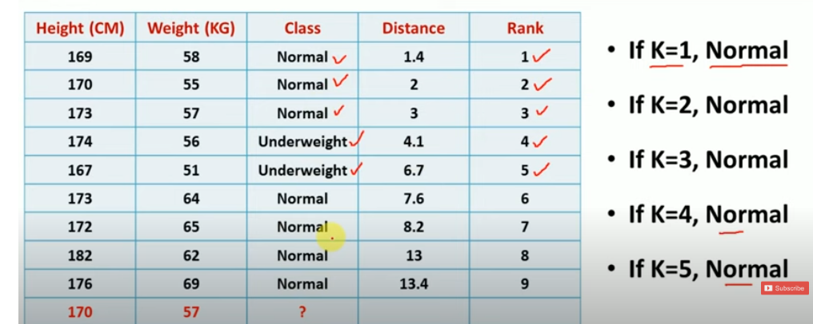

Slide 18
Numerical
Given K=3
Maths | English | Result
4 | 3 | Fail
6 | 7 | Pass
7 | 8 | Pass
5 | 5 | Fail
8 | 8 | Pass
6 | 8 | ??

Slide 20
Thank You

